Slide 1

Analyzing Personal Expenses
Programming Language: Python
Database: MySQL
Application: Streamlit

Slide 2

Objective
Project aims to simulate an expense tracker for an individual.
The tracker will highlight expenses across categories like bills, groceries, subscriptions, and personal spending, providing a comprehensive overview of financial habits over a year.

Slide 3
Plan
To generate fake expenses for a year using Python.
Create a MySQL connector from Python to MySQL Database.
Upload the data from Python into MySQL.
Generate MySQL queries to derive insights into spending behavior.
Use Python and Streamlit app to output the MySQL query results.

Slide 4
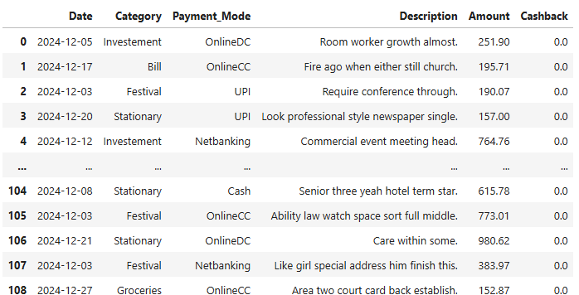
Fake Expense Data
Fake Expense data generated in Python:

Slide 5
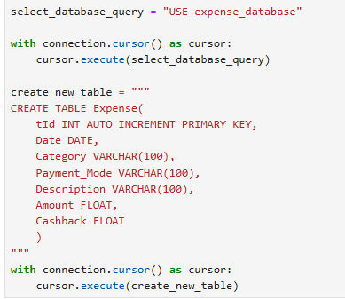
MySQL Database
Create a MySQL Connector from python to MySQL Database.
Create a Database called Expense_Database and a table called expense from Python.
Move data from Python to MySQL

Slide 6
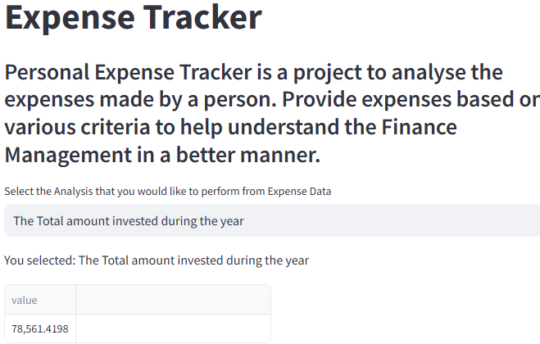
Streamlit App
Generate various MySQL queries to develop insights on the spending pattern.
Use Streamlit “Select Option” – drop down list to create 16 set of questionnaire and integrate a MySQL query to each question.

Slide 7
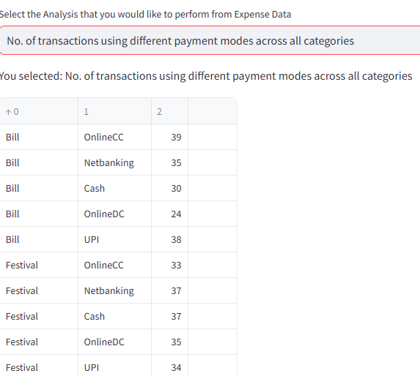
Sample Streamlit App Results

Slide 8
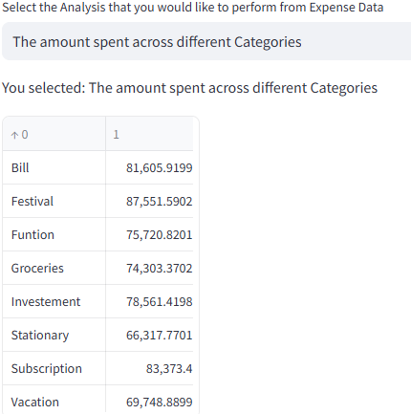
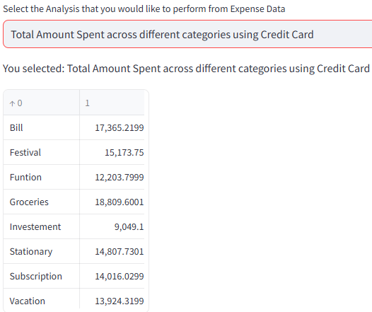

Slide 9

Thank you

